Slide 1
How to become an Aspiring Architect
Karthikeyan VK
MVP Azure
Cloud Native Architect

Slide 2
My Story

Slide 3
THE Burning WHY
Those who have a 'why' to live, can bear with almost any 'how'. - Viktor Frankl
Notes:
Motivation for free.
Think of last time you were extremely motivated and ready to do whatever it takes
First find your "Why" you want to be better than what you are now.

Slide 4
THE Burning WHY
To get promotion to next level
I might lose my current job.
To Earn more..
Hate a person in my company and want to prove I am technically better than him.
I feel insecure when people around me talk about latest technology. And I cannot contribute anything to the conversation.
More Personal, More Universal…
TELL YOUR REAL WHY
Notes:
Let's concentrate and prioritize things
Helps you to get more out of learning and any activity you do..
What is your WHY

Slide 5
Your Why

Slide 6
List your goals
List the Five goals you want to reach in 5 Years

Slide 7
Mindset of an Architect
Taking Responsibility
Thinking long term
Self Discipline and Focus
Self Talk
Sense of Deservingness
Cause and Effect

Slide 8
Taking Responsibility
Responsible for everything
No Blame attitude
Accept Them as They Are

Slide 9
Responsible for everything
All blame is a waste of time. No matter how much fault you find with another, and regardless of how much you blame him, it will not change you." — Wayne Dyer
Notes:
Reduces Stress
You become better person
Opportunities flows your way.
You learn how to do things both personally and professionally, you know there is more than two technique to handle in case of problem, fight or flight
Your brain is active
don't criticize, condemn or complain
50K-60K signal per day = > brain generalizes=> if responsible, you can remove the generalization and solve the problem.

Slide 10
Responsible for everything
Notes:
Sales, marketing, finance, House keeping, board meeting

Slide 11
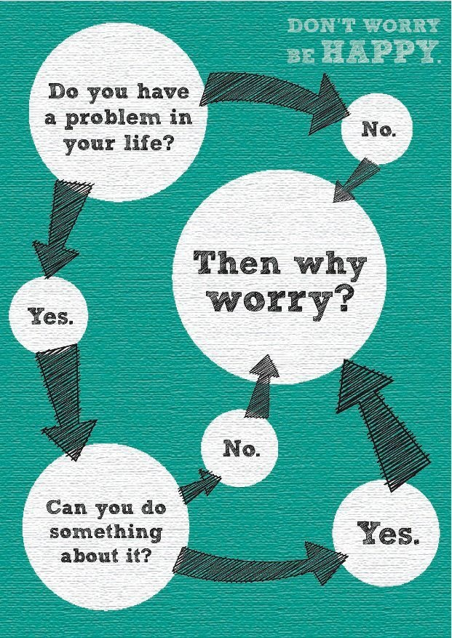
Responsible for everything
Notes:
Reduces stress
Circle of influence
Story - my lead treated me bad when i was a fresher.

Slide 12
Responsible for everything
Last Five things that bothered you, what can you do about it, only one small step!

Slide 13
No Blame Attitude
Don't criticize, condemn or complain
- Dale Carnegie,
Author of “How to win friends and influence people”.
Most sold book next to bible.
Notes:
You will attract great people in your life
People with high status will always look out for how you talk about other
Why because they know this how you will talk in their absense.
Build trust not likeness
Gossip and blame creates a initial bond but not trust...
Take a 30 day challenge
I will contradict this by saying have an opinion on everything.

Slide 14
No Blame Attitude
Don't criticize, condemn or complain
- Dale Carnegie,
Author of “How to win friends and influence people”.
Most sold book next to bible.
Notes:
You will attract great people in your life
People with high status will always look out for how you talk about other
Why because they know this how you will talk in their absense.
Build trust not likeness
Gossip and blame creates a initial bond but not trust...
Take a 30 day challenge

Slide 15
Accept What they are
Don't criticize, condemn or complain
- Dale Carnegie,
Author of “How to win friends and influence people”.
Most sold book next to bible.
Notes:
You will attract great people in your life.
People with high status will always look out for how you talk about other
Why because they know this how you will talk in their absense.
Build trust not likeness
Gossip and blame creates a initial bond but not trust...
Take a 30 day challenge

Slide 16
Thinking
Long Term
Find Your Purpose
Saying No
Visualizing your Funeral

Slide 17
Find your Own Purpose
We tend to overestimate the effect of our work in the short run and underestimate the effect in the long run,
Notes:
Gives you sense for living
Bigger it is better.
Gives you a meaning to get up everyday and jump to work.
Think of how good you want to complete your work because you want to go to your native or vacation
Life is lived everyday instead of saturday and sunday.
Talk about closing room and figuring out your purpose.
Tell your story about visa being rejected how devastating you were.
Felt empty when your purpose is small. Once you get there you will feel empty.
Law of attraction

Slide 18
Find your Own Purpose
We tend to overestimate the effect of our work in the short run and underestimate the effect in the long run,
Notes:
Gives you sense for living
Bigger it is better.
Gives you a meaning to get up everyday and jump to work.
Think of how good you want to complete your work because you want to go to your native or vacation
Life is lived everyday instead of saturday and sunday.
Talk about closing room and figuring out your purpose.
Tell your story about visa being rejected how devastating you were.
Felt empty when your purpose is small. Once you get there you will feel empty.
Law of attraction
Begin with end in mind - architect way

Slide 19
Find your Own Purpose
“Ultimately, man should not ask what the meaning of his life is, but rather must recognize that it is he who is asked. In a word, each man is questioned by life; and he can only answer to life by answering for his own life; to life he can only respond by being responsible.”
― Viktor E. Frankl, Man's Search for Meaning
Notes:
Gives you sense for living
Bigger it is better.
Gives you a meaning to get up everyday and jump to work.
Think of how good you want to complete your work because you want to go to your native or vacation
Life is lived everyday instead of saturday and sunday.
You life will go in a upward spiral, you will know what you don't know and you will find people automatically who can teach you or guide in the path, that takes you there.
Talk about closing room and figuring out your purpose.
Tell your story about visa being rejected how devastating you were.
Felt empty when your purpose is small. Once you get there you will feel empty.
Law of attraction
Begin with end in mind - architect way

Slide 20
Find your Own Purpose
How to find my purpose ?
Notes:
I cannot help you with that, you need to figure out how can you contribute to the society, it can be anything that will help you to get people around you better.

Slide 21
Find your Own Purpose
Write you life major purpose here, In which way you will contributing back to the society ?
Notes:
I cannot help you with that, you need to figure out how can you contribute to the society, it can be anything that will help you to get people around you better.
If you find the people who has the same purpose.

Slide 22
Saying No
Things which matter most must never be at the mercy of things which matter least
Notes:
You do low leverage activity such as facebook, whatsapp or reading news, unwanted gossiping,. You are wasting time,

Slide 23
Saying No
Things which matter most must never be at the mercy of things which matter least
Notes:
You do low leverage activity such as facebook, whatsapp or reading news, unwanted gossiping,. You are wasting time,

Slide 24
Visualize your Own Funeral
Husband/Wife
Kids
Office colleague
Neighbour
Community member

Slide 25
Visualize your Own Funeral
What would you like each of these people to say about you and your life?
Husband/Wife
Kids
Office colleague
Neighbour
Community member

Slide 26
Self Discipline &
Focus
Forming Habits
Getting More things done
Notes:
Power of habits.
CRA - Clue, Routine, action

Slide 27
Forming Habits
“Shallow men believe in luck or in circumstance. Strong men believe in cause and effect.”
Notes:
In Late 2011, a teenage father starts receiving all baby products coupons, so he called the Target shop manager and bashed that is Target is store is sending these coupon to encourage my teenage daughter to get pregnant. But the nice store manager has no idea what he was talking and apologised for the mistake that has happened.
Failure / success does not happen in a day.
So if you find what are all the habits of the successful people and copy them, you will also be successful

Slide 28
Forming Habits
“As people strengthened their willpower muscles in one part of their lives—in the gym, or a money management program—that strength spilled over into what they ate or how hard they worked. Once willpower became stronger, it touched everything.” - Charles Duhigg, The Power Of Habit
Notes:
We are auto pilot mode,
Find your bad habits
Second replace it with good
Wake up 6:30 instead of 7:00 for 21 days, and add gym or walk
Reset it 21 days
Piggy back
There is limited will power at our disposal
Talk about system 1 and system of “Think Fast and slow”

Slide 29
Forming Habits
List out one thing you will do tomorrow that will create ripple effect(eg: waking up early ) . And what are the ripple effects you can envision ?
Clue: Look into one of your goal!

Slide 30
Getting More things Done
“Innovation is saying no to 1,000 things” - Steve Jobs
Notes:
How focus can make you highly productive
Think of last time you were highly productive
Talk about focus
Steve jobs, when he returned to apple after being thrown out, comes out and sacks all the products and then only concentrate on product on each segment.
If you want to get one thing right, that is getting your focus to only things which will lead long term success then you will be better of from it.

Slide 31
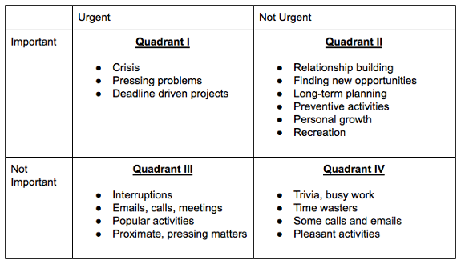
Getting More things Done
Notes:
Build trust once you follow.
Let people know you work on the important and create a name that you are the one.

Slide 32
Getting More things Done
Write down your worst quadrant IV activities eg:- Checking whatsapp, every 2 microsecond
Notes:
Build trust once you follow.
Let people know you work on the important and create a name that you are the one.

Slide 33
Getting More things Done
Write down three activities you have been procrastinating which is the quadrant II activities
Notes:
Build trust once you follow.
Let people know you work on the important and create a name that you are the one.

Slide 34
Self Talk
Finding Your Vocabulary
Finding Your affirmation
Useless negative self talk

Slide 35
Finding Your vocabulary
I can’t’
I need to … I should ….
i never … I no longer ….
I am
It is
Notes:
Is change must in our life ??
It all means i cant change , i dont have control,

Slide 36
Positive Affirmation
I am Unstoppable
I am good at what i do
I am great at what i do
I am here to succeed in this world
Everything happens in my life, happens for me to succeed
Everyone around me works for my success
I get stronger everyday.

Slide 37
Positive Affirmation
What is your positive affirmation ?(Write one from the above list or make your own one) ?

Slide 38
Positive Affirmation
What is your positive affirmation ?(Write one from the above list or make your own one) ?

Slide 39
Useless Negative self talk
What did you suffer last time and it turned out nothing

Slide 40
Useless Negative self talk
What are the three things you want to change in your life in negative context you use?

Slide 41
Useless Negative self talk
Change it into positive affirmations

Slide 42
Useless Negative self talk
Change it into positive affirmations

Slide 43
Sense of Deservingness
Giving yourself the permission
Fear of Success
Notes:
Lottery Story
you buy just to show other that you can afford. It internally says you feel you dont deserve
My story on increasing my salary to 12 lakhs
When we start giving yourself the permission to whatever we want in our life, we tend to get what ever we want

Slide 44
Giving Yourself the permission
Write one thing you want but you feel you don't deserve ?

Slide 45
Fear of Success
What do you fear will happen when you get what you want ?

Slide 46
Fear of Success
What is the worst thing that might happen when you get what you want ?

Slide 47
Cause & Effect
Understanding Cause & Effect
Copy your model

Slide 48
Understanding Cause & Effect
Everything happens for a reason. For every cause there is an effect, and for every effect, whether you know it or not, there is a specific cause or causes. There are no accidents.

Slide 49
Understanding Cause & Effect
“Pay the price” - UpFront

Slide 50
Understanding Cause & Effect
“Pay the price” - UpFront

Slide 51
Copy Your model
Find your goal on how much of successful architect you want to become
Find the person who has already achieved that goal, you will become like them.
Follow the person and study their success habits.
Do what they do every day.

Slide 52
Copy Your model
Who is your model, whom you want to become?

Slide 53
Copy Your model
What is one thing you can do that your model is doing today?

Slide 54
Personal Hygiene
Bathe Regularly
Don't wear the same shirt twice without washing.
Check your body odor
Shave your armpit
Trim your nails
Check your hairstyle
Check your breath
Keep your hands clean

Slide 55
Confident Body Language
Practice Smiling
Pay Attention to posture
Remember your Arms and legs
Have a strong Handshake
Dress for confidence
Identify Fidgeting
Eye Contact
Take more space

Slide 56
Characteristics of an Architect
Principal based life
Emotional Intelligence
Handling Politics
Being Open to change
Good Communicator

Slide 57
Principal Based life
You Don’t Control The Outcomes Of Your Life, Principles Do. - Stephen Covey
Notes:
you will feel more secure
You tend to not get into silly quarrels and not get carried away by the person who challenges your technical decision
Your will be more powerful because you are self aware, knowledgeable, proactive individual, largely unrestricted by the attitudes, behaviours and action of others.
When you are not living principle based life, Frustration will be more, because we tend to get distracted with someone’s expectation
If your life is not principle centered, You tend to be more constrained with your perspective of life because you tend to surround yourself with people you are comfortable with and not people you are not comfortable with

Slide 58
Principal Based life
Sense of control
Sense of coherence
Notes:
Information = control
Walk your talk

Slide 59
Principal Based life
Never compromise with Honesty and Integrity
Obtain counsel of others
Defend those who are absent.
Controlling vs being in control
Examining your motive
Building Character vs reputation

Slide 60
Principal Based life
Building Trust vs likingness
Notes:
We will talk about the self trust in detail. You can create self trust, when you concentrate on four factors.
Integrity: Deep honesty and truthfulness; who we really are; congruence, humility, and courage.
Intent: Our plan or purpose —our motive, our agenda, our behavior.
Capabilities: Our capacity to produce and accomplish tasks through talents, attitudes, skills, knowledge, style.
Results: Our track record—based on past performance, current performance, and anticipated performance.

Slide 61
Emotional Intelligence
Understanding Emotions
Understanding brain
Empathetic Listening
Never Argue
Being Sincere yet Decisive

Slide 62
Understanding Emotions
Name all emotions ?

Slide 63
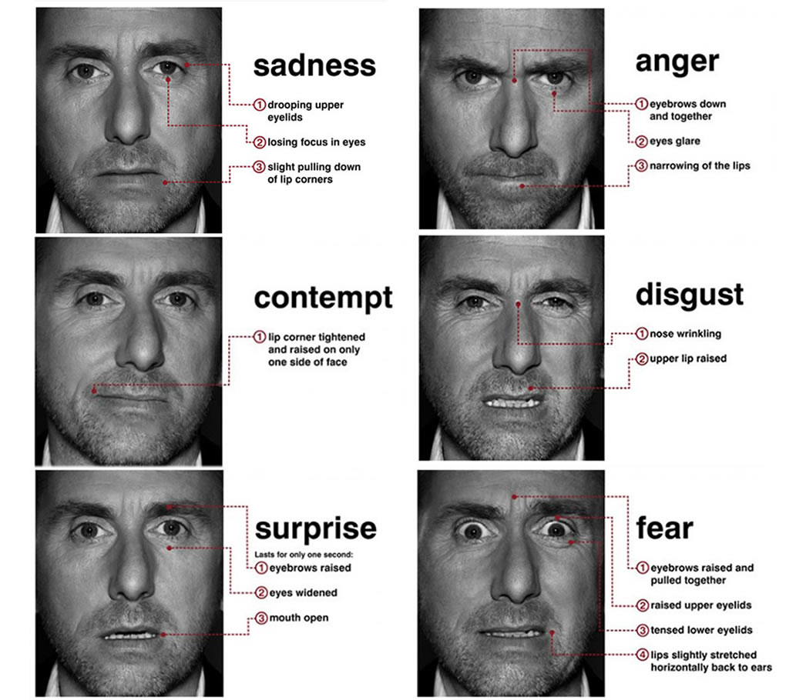
Understanding Emotions

Slide 64
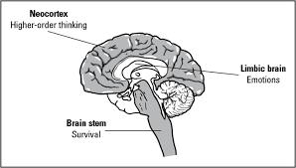
Understanding Your Brain
Notes:
Think of last time you were sad.
Think what made you sad or what is the situation or what is the person or what action by a person or what words made you sad.
What was the actual emotions ? is it guilt, regret, revenge, embarrassment ?

Slide 65
Empathetic Listening
“Most people do not listen with the intent to understand; they listen with the intent to reply.” -Stephen R. Covey
Notes:
Only give advise when they ask for.

Slide 66
Never Argue
“If you argue and rankle and contradict, you may achieve a temporary victory - sometimes; but it will be an empty victory because you will never get your opponent's good will” - Benjamin franklin

Slide 67
Be Sincere Yet Decisive
Any decision you make isn't worth a tinker's, until you have formed the habit of making and keeping it - Henry ford
Notes:
Sincere means proceeding from genuine feelings. As much think we are logical creature, we are not one. We are only driven only by our emotions. As Freud, the famous psychologist says we are driven by pain and pleasure principle.
We do more of things that gives us pleasure and avoid things that gives us pain. We try to avoid pain as much as possible.
That is where procrastination comes in because the procrastination is mostly due to fear of unknown and not knowing what to do next.

Slide 68
Handling Politics
Good Politics
Dark Side of You
Don't be Naive

Slide 69
Good Politics
High Integrity
Kindness
Intelligence
Generosity
Self awareness
Notes:
Based on above rule.
Project and company success is the key, ego is not the key here.

Slide 70
Dark Side of You
Accept Your Dark Side
Inner completion
Comfortable with dark side with others
Notes:
Your dark side is what you hate most in yourself. It’s your fear of failure, it’s your extreme shyness or your selfish motives that pop during pressure.Whenever there is an extreme emotion on other person behaviour that is time your dark side is revealed.
First of all, when you accept that you do have a dark side and that is part of you, all the energy that you spent in fighting it, will suddenly be available for other purposes.
Integrity here means you know you have a bad side and you are ok with it being part of you.
I’m not only this respectable person, but I am also this shy and sad person who fears social contacts. So? This is me, and I know from where I start and where I end. I established my whole territory now. You can accept me or not, but I know that I accepted myself, and that’s ok.”.

Slide 71
Good Politics
Dunning–Kruger effect
Notes:
Dunning–Kruger effect is a cognitive bias wherein people of low ability suffer from illusory superiority, mistakenly assessing their cognitive ability as greater than it is.
Am talking about some manager who thinks he is technically good and projects himself.
And if we are against him for taking our works credit, he is waiting for us to make mistake, so he can pound us, so we cannot get up.
You need to understand one thing, information is power. If you dont give any information, they will not have any power your project or over your work

Slide 72
Don’t Be Naive
Never let anyone take credit for your work
Never run away from limelight
Don't like your immediate boss leave the company
Never let all cats out of the bag

Slide 73
Don’t Be Naive
Never Attack anyone personally
Never Complain to your superior about anyone
Beware of what you talk in presence of your competitor

Slide 74
Don’t Be Naive
Correct yourself when your enemy gives feedback
Never document your disabilities
Person’s bad behavior doesn't change overnight
People who works for you, needs your attention. It is acceptable

Slide 75
Don’t Be Naive
Beware of too much compliments
Always have company’s growth as greatest priority
Everyone is dispensable
You pull the plug before it is too late
Notes:
Who moved my cheese” by Dr. Spencer.

Slide 76
Being Open to Change
Identify Your allies
Seeing the bigger picture
Address Fear change brings
Become Communication manager
Notes:
You should always good to people and treat with respect. You should never be a self serving leader.
Since you are no longer attached to the method which is executed, you will be mentally free and you will also be empowering your co-workers to find their method and correct them if needed.
Change bring fears because people are comfortable the way they are. All our action is based on either survival or replication, so we unconsciously know when they are is change in the environment,
Communication manager role are responsible for conveying organizational internal and external messages. functional and non-functional requirement to the team. You should not just leave it to the business analyst. Communication is a very slow process and it takes time.
Feedback helps to check whether the path you moving is right and aligns with company’s goals. All you need is to ask. And shut up.

Slide 77
Good Communicator
Listen, Talk & Read more
Learning about Body languages
Think before you communicate
Engage Audience
Ask for Honest feedback

Slide 78
Listen, Talk & Read more
Notes:
Talk about mastery, on how to learn from guru. Copy and then adapt to your version.

Slide 79
Learning about Body languages

Slide 80
Think before you communicate

Slide 81
Engage Audience

Slide 82
Ask for Honest feedback

Slide 83
Leader in Architect
Best Motivator
Leader Vs Manager
Getting Things Done

Slide 84
Best Motivator
Autonomy
Encouraging Mastery
Purpose
Trust and Responsibility
Facilitate to Learn new technology
Notes:
Train people well enough so they can leave, treat them well enough so they don't want to - Richard Branson, Founder of Virgin Group.

Slide 85
Leader Vs Manager
Doing things Right
Collaborating a project
First Who then What
Measure to Manage
Not to do as Manager
Notes:
Colloborate: Team focused,Generous,Curious,Builds relationships; breaks down walls
Get the right people
Get the right people in right seats, Get off the wrong people, Put who then what
Not being manipulative, no admin works, you don't care they take leave or not

Slide 86
Getting Thing Done
Become Highly productive
Becoming demon developer

Slide 87
Become Highly Productive
Awareness
Will Power
Building Rituals
Reducing friction
55-10-55-30 Rule
Schedule your distraction
Making Success Inevitable

Slide 88
Awareness
Notes:
When you are aware of your own distraction and find ways to get out of it, you will find lots of time to do what you want to do for a long time.
Awareness is conscious about what you are doing and not feeling guilt about it. Do we not feel guilt when we do things that are not productive such as watching a tv series or movie to pass time.
Talk about two ways of solving problem, one is just focusing and another is walking out.
So Awareness is knowing, you can be productive on both fronts when you are sitting at desk and also not sitting in desk.
Kill the buddha
If you are having fun be 100% indulged in the fun and not feel guilt about it. If you are working then give your 100%.

Slide 89
Will Power
Secret to success is using willpower consciously.
Notes:
“marshmallow experiment” - Walter Mischel
Let's say you have planned to go for running tomorrow morning
Your Will Power is limited,
Remove all the success preventing activities from your life
Outsource any work if you're not good at.
Build habits that make everything you want to do as second nature.

Slide 90
Building Rituals
We are what we repeatedly do. Excellence, then, is not an act, but a habit. -- Aristotle
Notes:
Only few people are conscious have an habit of trying out new things everytime.
It is almost impossible to do anything when we need to remember the steps to do an activity.
Remembering the steps to do any activities is really really hard.
If something is important in your life, it make sense to do it every day and make it an habit, so you don't have to have the resistance that comes when you need to remember the steps.
For example, you are planning to go for a running tomorrow. If you have planned in detail before night on getting the shoe ready , your earphones ready for listening to songs, even downloaded the song you need to listen tomorrow that will motivate you. You will be more probable you will go for a run tomorrow.
If you haven't planned in detail and when you wake up, you will think i need to search for my shoe, so i will skip today and tomorrow i will do it.
Identify the CUE= > Find the Reward = > Identify and change the routine

Slide 91
Reducing friction
“By acknowledging, accepting, and embracing our dark side, we create natural steam vents within ourselves. By providing an opening, we eliminate the worry about an explosion because we are allowing the pressure to be released in a safe and appropriate way” - Debbie Ford
Notes:
Two parts for own good and let them talk to each other. Each part exists for a reason, the most productive way is to acknowledge them and listen to them. Let them listen to each other.

Slide 92
55-10-55-30 Rule
Notes:
There are two aspect of focus : quantity and quality.
Write down the two important task that will help your career.
.
.
Write down the benefits you will get when you finish the tasks in order
.
.
Write down the what you will lose if don't finish the tasks
.

Slide 93
Schedule your distraction

Slide 94
Making Success Inevitable
Notes:
In the book, “Influence”, Robert cialdini talks about Commitment & Consistency. There’s a story Cialdini tells about an experiment where a group of people were given a cancer awareness button and asked to wear it for a week. Most all thought it was a harmless request, and compiled

Slide 95
Become Demon Developer
Technical Mindset
Developers developer
Devops Expert
Learn methodology
Pragmatism

Slide 96
Technical Mindset
Programming is Hard not impossible
Embrace the pain
Not Yet strategy
Not forgetting your success story
Everything is learnable and beginning is always hard
Learned to walk away and come back

Slide 97
Developer’s Developer
Remove noise for developers
Removing the most painful
Trying out new tools
Learning how to write a framework

Slide 98
Devops Expert
Principles
Knowing how to start in any project
Devops is recurring process.
No exception in spite of releases schedule.

Slide 99
Pragmatism
Beginner mind
Knowing you may be wrong
Ethics
Practical learning

Slide 100
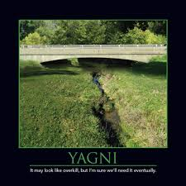
Learn Methodology
Yagni
Rapid Application Development
Agile Software development
Notes:
Agile is all about speed.
Agile does not mean quality can be compromised.
Slicing your development work as a multi-layer cake
Agile works better once project has completed the Sprint zero.
Agile works better for maintenance and support project.
Hybrid of Agile and waterfall works better for development project.
Devops and automation should be default in Agile.

Slide 101
Become Sales/Marketing guy
Everyone is salesperson
Identify your customer
Positioning
Build digital presence
Build the Network

Slide 102
Technology Skills
SOLID Principles
12 Factor app
Design for extensibility.
Architecture Documentation.
Build Framework

Slide 103
SOLID Principles

Slide 104
12 Factor App

Slide 105
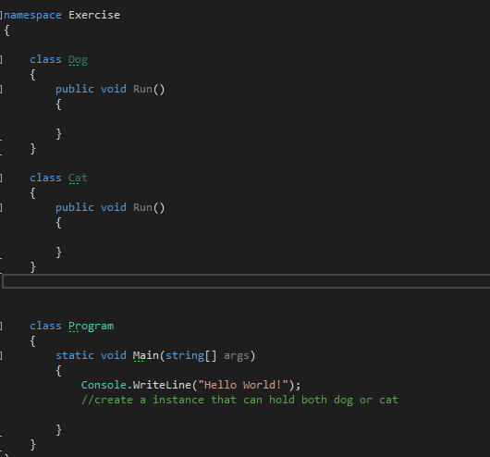
Design for Extensibility

Slide 106
Architecture Documentation

Slide 107
Why Viewpoints & Perspectives
It is not possible to capture the functional features and quality properties of a complex system in a single comprehensible model that is understandable by and of value to all stakeholders.

Slide 108
What is Viewpoints ?
A viewpoint is a collection of patterns, templates, and conventions for constructing one type of view.
It defines the stakeholders whose concerns are reflected in the viewpoint and the guidelines, principles, and template models for constructing its views.
Notes:
Approximation of reality

Slide 109
What is Perspective?
An architectural perspective is a collection of activities, tactics, and guidelines that are used to ensure that a system exhibits a particular set of related quality properties that require consideration across a number of the system’s architectural views.
Eg: - Accessibilities, Security, localization, availability and all ity’s

Slide 110
Viewpoints
Functional viewpoint
Informational viewpoint
Concurrent viewpoint
Development viewpoint
Deployment viewpoint
Operational viewpoint

Slide 111
Build Framework
Qualities of well designed framework
Principles of framework design
Common Design patterns

Slide 112
Beyond Architect
Swimming with Sharks
Getting to next level

Slide 113
Beyond Architect
Swimming with Sharks
Getting to next level

Slide 114
Swimming with Sharks
It’s all about positioning
Learn negotiations
Person with money meets person with experience
Spotting a winner
Get bored easily
There is no such thing as bad memory
Take millionaire to lunch
Notes:
Getting to yes
Always think win-win or no deal
Always look for people who has the spark and make them your allies
Always look for new things to do, scratch before itch, find a place before it breaks. Move your cheese book
It is lonely at the top, so you can hear stories ,because every one like a stroking of their ego. So go for it

Slide 115
Getting to next level
Don't take sides
Avoid destructive comments
Avoid telling the world how smart you are
Adding 2 cents to every conversation.
Getting better by Following up.

Slide 116
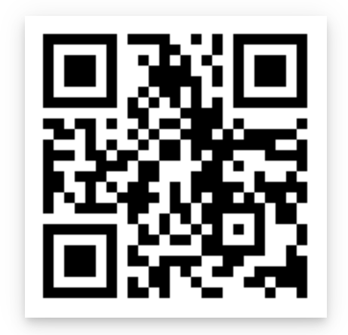
Subscribe to aspiring youtube channel.

Slide 117
Remember one thing
Give yourself permission to succeed and you definitely will.

